Slide 1
CS 104 Robot Project slides
By: Miriam Abecasis, Daniel Crawford, Benedetto Aiello, and Arnav Vasa

Slide 2
Role of Each Team Member
Arnav Vasa | Repository Manager | -Manage the repository -Develop the block code -Troubleshoot code -fill out section 5 of the System Design Document
Benedetto Aiello | Document Designer | -Fill out the system design document -Develop the algorithm
Miriam Abecasis | Group Leader | -Fill out the system design document -Video the robot -Organize group meetings
Daniel Crawford | Quality Control | -Make the flowchart -Make the gantt chart -Troubleshoot code

Slide 3
Challenges We Faced
There were very few issues we faced during our time doing this project
The floor was uneven this posed a challenge and made it so that we had to code the robot very carefully to make sure it did what it needed to do
The next challenge was more of an initial thing, it was the document for the different sprints, this was only a bit confusing initially but as time went on we got the hang of what to do and it was easy from there
A smaller challenge the group faced was meeting times, there were always days we would meet together but there were other days were only a select few members could meet, in the end it worked out since our group had good communication with each other and we were all able to get our parts done
There wasn’t too much more that was challenging, out group worked well together and we got work done, we made a great team, and that goes to show teamwork makes the dreamwork!

Slide 4
What We Learned About Software Engineering
Algorithm Design and Optimization: We gained practical experience in designing and optimizing algorithms to guide the robot's movement along specific paths. This taught us the importance of critical thinking when solving real-world problems and optimizing code for efficiency.
Testing and Debugging: Through the project, we honed our skills in systematically testing our code, identifying and resolving issues such as collision detection problems, navigation errors, and unexpected behaviors. This hands-on experience was invaluable for improving the reliability of our software.
Hardware Integration: We learned how to integrate software with physical hardware components like sensors, motors, and lights. We also learned the importance calibration for optimal performance.
Project Management: Managing the various project phases, setting milestones, and meeting deadlines became a learning experience. We acquired project management skills such as planning, scheduling, and resource allocation, which are crucial aspects of successful software engineering projects.

Slide 5
What We Would Do Differently
Uneven Floor Challenge:
Before starting a project, we should conduct a thorough inspection of the environment where the robot will operate. If possible, address any physical challenges like an uneven floor or obstacles in advance
Documentation Challenge
Invest more time upfront in understanding and clarifying project documentation. If we find any aspects of the project requirements or instructions confusing, we should seek immediate clarification from our teacher or team members
Meeting Time Challenge
Utilize collaboration tools like scheduling apps or shared calendars to coordinate meeting times efficiently and avoid conflicts.

Slide 6
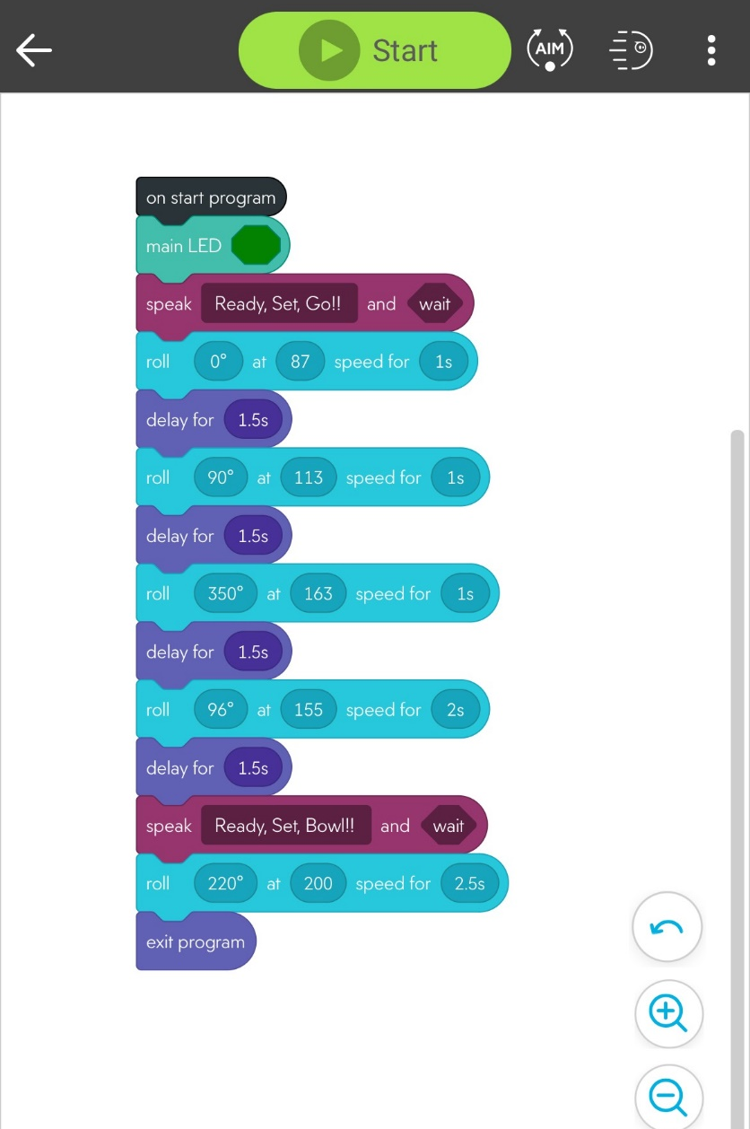
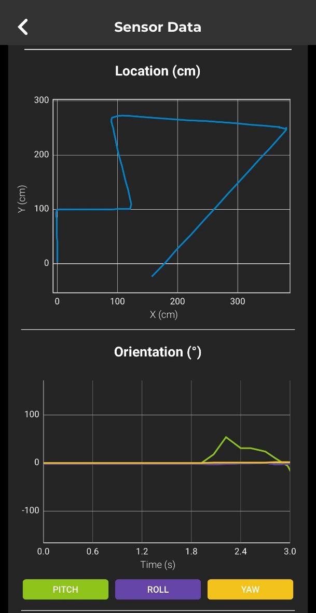
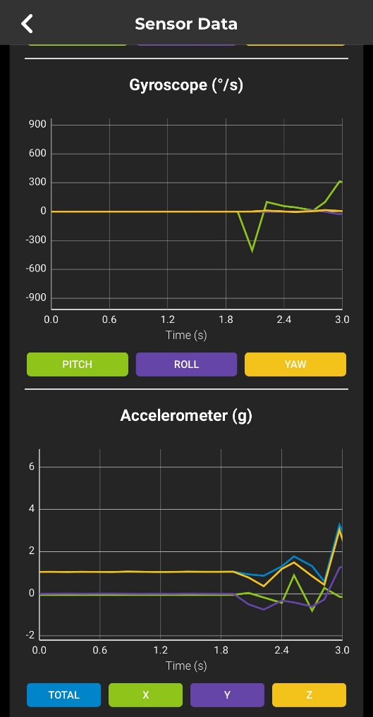
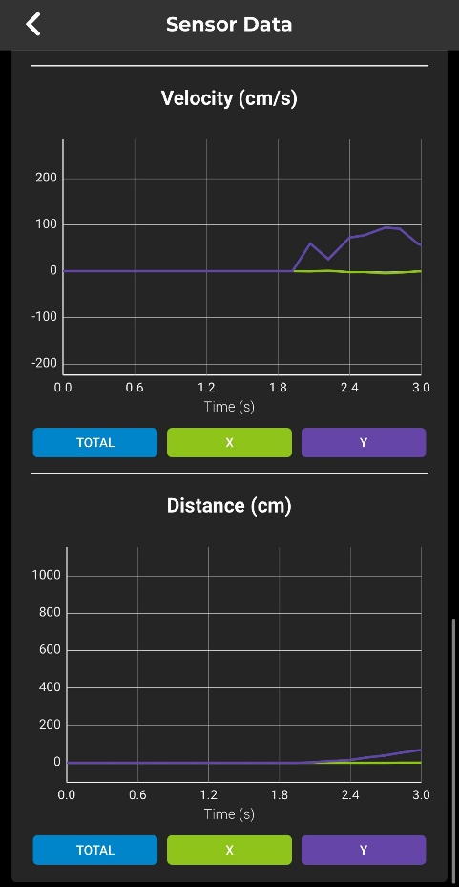
Block Code For Sprint 3

Slide 7



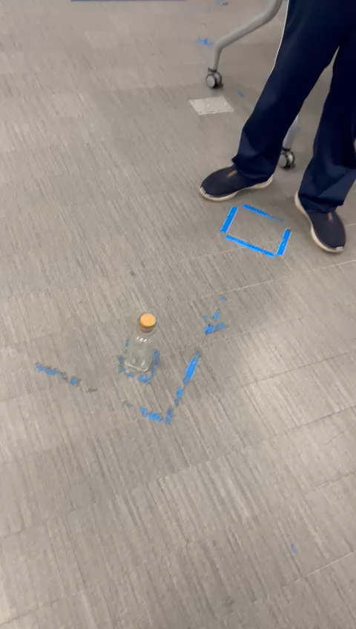


Sprint 3 Video:

